Slide 1
Power BI Data Sources
FSI CSU SWARM

Slide 2
Introduction

Slide 3
Abstract and learning objectives
Learn Data Sources available to Power BI

Slide 4
Data Sources
Embedding Power BI Content | The Power BI service (SaaS) and the Power BI Embedded service in Azure (PaaS) have APIs for embedding your dashboards and reports. This feature means you can access the latest Power BI features – such as dashboards, gateways, and app workspaces – when embedding your content.

Slide 5
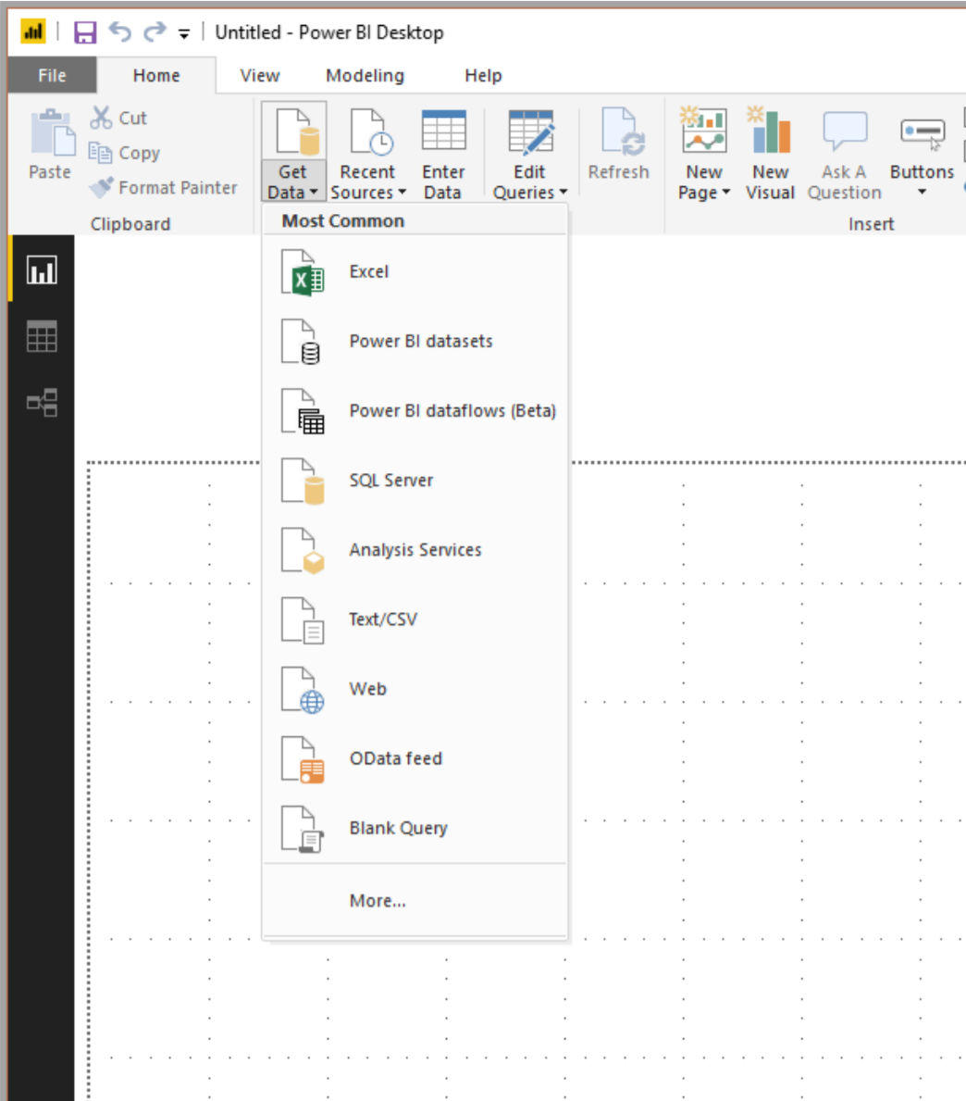
Connect to Data
To connect to data, select Get Data from the Home ribbon.Selecting the down arrow, or the Get Data
text on the button, shows the Most Common data types menu shown in thefollowing image:

Slide 6
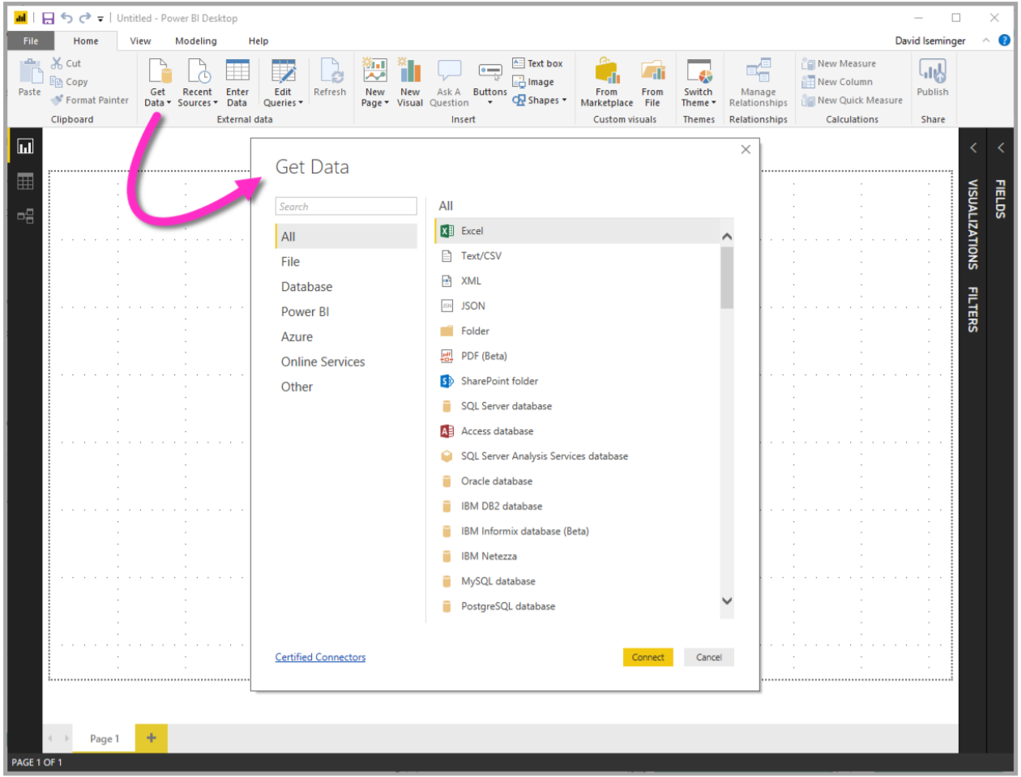
More Data
Selecting More… from the Most Common menu displays the Get Data window. You can also bring up the Get Data window (and bypass the Most Common menu) by selecting the Get Data icon button directly.

Slide 7
Wrap Up

Slide 8
Wrap-up
Outcome
Identify the preferred solution for the case study
Identify solutions designed by other teams
Timeframe
15 minutes

